Slide 1

Title slide + image
Technology Dynamics
(MOT113A)
Group 14

Slide 2
Table of Contents
Core Contribution
Key Concepts & Relationships
Link to Conceptual Framework
Critical Discussion
Conclusion
Discussion Question

Slide 3
Paper Contribution (Murmann & Frenken, 2006)
"Toward a systematic framework for research on dominant designs, technological innovations, and industrial change""
Key Idea | Details
Unified Framework | For studying dominant designs
Nested Systems | Systems → Subsystems → Components
Design Evolution | Each level evolves over time
Pleiotropy | Defines core vs. peripheral components
Core Components | Affect many functions → Hard to change
Peripheral Components | Affect few functions → Easier to change
Clarifies Past Research | Definitions, cause-effect links, and level of analysis
Practical Relevance | Helps study tech stabilization and industry dynamics , prevents confusion
Notes:
Aims to create a clearer and more systematic way to understand how dominant designs emerge and shape technological and industrial change
Proposes a unified framework for studying dominant designs.
Treats products as nested systems with design cycles at different levels.
Introduces pleiotropy to define which components are core vs. peripheral helps explain which parts of a system lock in and which stay flexible.
Clarifies confusion in earlier research on definitions, cause-effect relationships and what level (system or component) to analyse.
Gives researchers and firms better tools to study how technologies stabilize and shape industry dynamics.

Slide 4
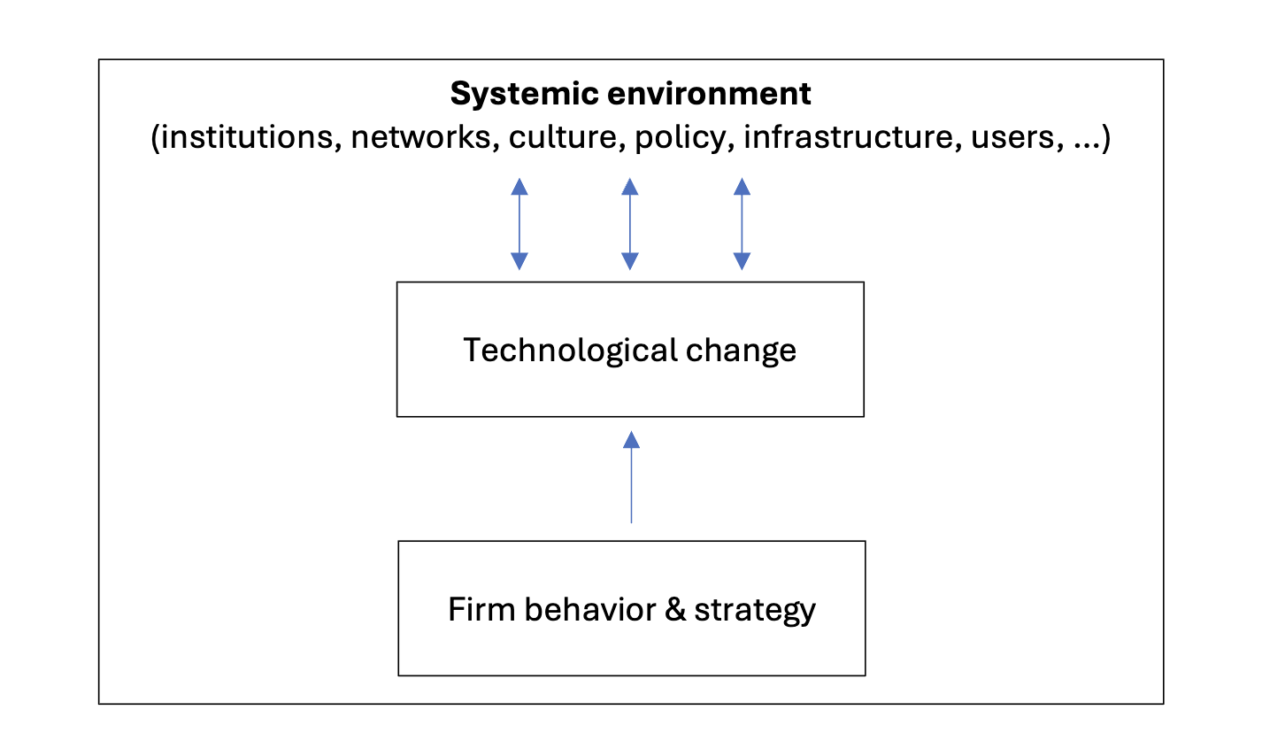
Link to course’s guiding conceptual model
Dominant design dictates organizations of industries and provides a measure of economic improvement
Era of incremental change
Market provides incentives for certain types of innovation
Era of ferment
Assessment of entry and exit barriers
Deciding on core or peripheral changes to product

Slide 5
Relationship Between Key Concepts
Dominant design acts an independent variable, causes shifts in innovations type, firm strategies & industry dynamics.
Innovation outcomes, market structures & organizational responses are dependent variables.
Contextual factors mediate the main effect.
Feedback loop exists where industry structure & firm behavior can reinforce the dominance of certain designs.
Independent Variable
Dependent Variable
Dominant Design
Innovation Outcomes, Market Structures & Organizational Responses
Independent Variable
Dependent Variable
Mediator
Network Externalities, Economies of Scale & Strategic Coalitions

Slide 6
Thank you for your time!

